Slide 1

Managing Risk

Slide 2
Chapter Concepts
Identifying risks and their potential impact
Assessing the likelihood of occurrence and degree of impact of risks
Risk response planning
Controlling risks

Slide 3
Learning Outcomes
Discuss what is involved in managing risks
Identify and categorise risks
Assess and prioritise risks
Prepare a risk response plan
Develop a risk assessment matrix
Control risks

Slide 4
Project Risk Management
Project Management Knowledge Areas from PMBOK® Guide

Slide 5
Identify Risks
Can jeopardise achieving the project objective
Brainstorm sources of risks
Establish categories for risks and evaluate
Use historical information
Progressively elaborate and identify new risks as more information becomes available

Slide 6
Assess Risks
Determine the likelihood the risk event will occur
Evaluate degree of impact on the project objective
Prioritise
Likelihood of occurrence and degree of impact
Position relative to the critical path

Slide 7
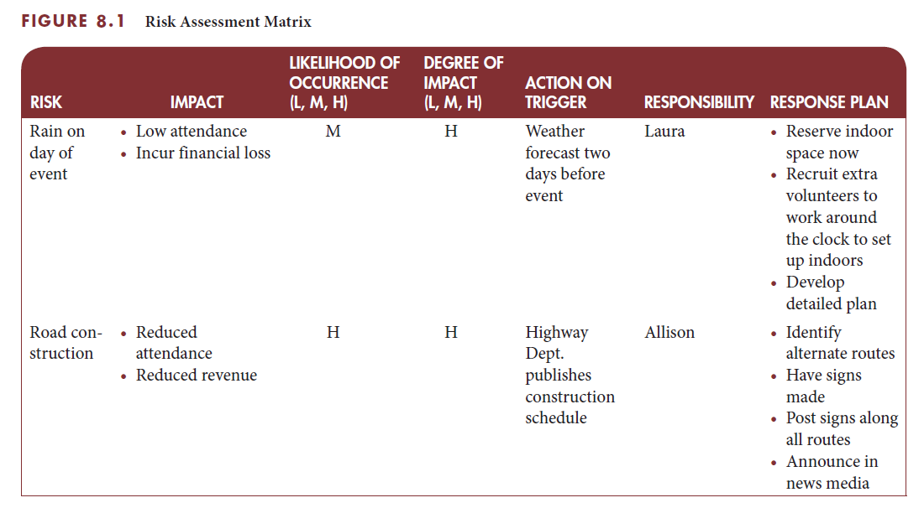
Risk assessment matrix

Slide 8
Plan Risk Responses
Set of actions
Prevent or reduce the likelihood of occurrence or the impact of a risk
Implement if the risk event occurs
Establishes a trigger point for implementing an action
Assigns responsibility for implementation
Avoid, mitigate, or accept the risk
Include a contingency fund to cover implementation cost

Slide 9
Managing Risks for Information Systems Development
Risks can be categorised into seven types
Technological risk
Human risk
Usability risk
Project team risk
Project risk
Organisational risk
Strategic and political risk

Slide 10
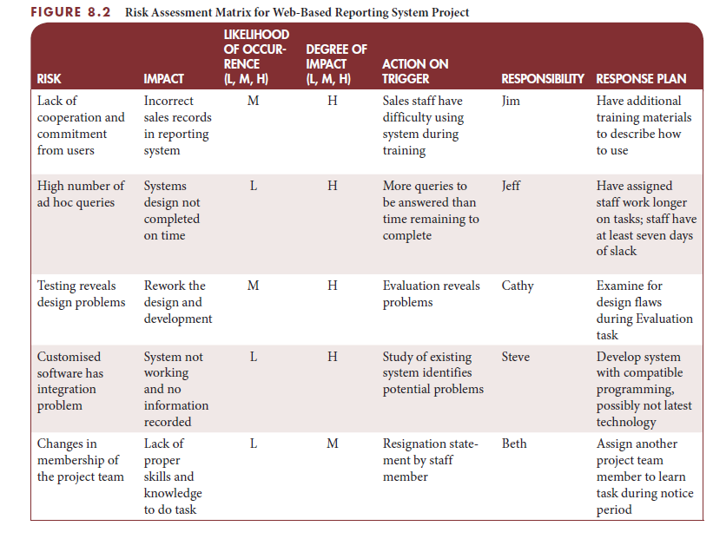
IS example: risk assessment matrix

Slide 11
Performing Quantitative Risk Analysis
Often follows qualitative risk analysis, but both can be done together
Large, complex projects involving leading edge technologies often require extensive quantitative risk analysis
Main techniques include:
Decision tree analysis
Simulation
Sensitivity analysis

Slide 12
Decision Trees and Expected Monetary Value (EMV)
A decision tree is a diagramming analysis technique used to help select the best course of action in situations in which future outcomes are uncertain
Estimated monetary value (EMV) is the product of a risk event probability and the risk event’s monetary value
You can draw a decision tree to help find the EMV

Slide 13
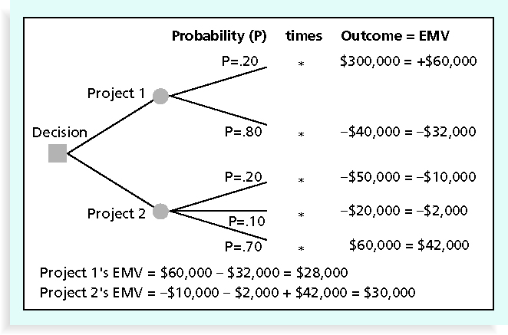
Figure 11-7. Expected Monetary Value (EMV) Example

Slide 14
Critical Success Factors
Identify risks and their potential impacts before the project starts.
Involve the project team or experts in assessing risks.
Assign high priority to managing risks that have a high likelihood of occurrence and a high potential impact on the project outcome.
Develop response plans for addressing high priority risks.

Slide 15
Summary
Risk is an uncertain event that, if it occurs, can jeopardise achieving the project objective.
Risk management includes identification, assessment, control, and response to project risks in order to minimise the likelihood of occurrence and/or the potential impact of adverse events on the achievement of the project objective.
Risk identification includes determining which risks may adversely affect the project objective and estimating what the potential impacts of each risk might be if it occurs.
Assessing each risk involves determining the likelihood that the risk event will occur and the degree of impact the event will have on the project objective, and then prioritising the risks.
A risk response plan is a defined set of actions to prevent or reduce the likelihood of occurrence or the impact of a risk, or to implement if the risk event occurs.
Regularly review and evaluate all risks to determine if there are any changes to the likelihood of occurrence or the potential impact of any of the risks, or if any new risks have been identified.

